Slide 1
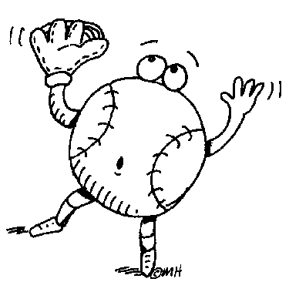
PROPERTIES OF PROPORTIONS
Suppose 4 baseballs cost $10. Assume you can buy any number of baseballs at this same rate. Make a double number line showing costs for different quantities of baseballs.
0 10 20 30 40
dollars
# of baseballs
0 4 8 12 16

Slide 2
A PROPERTY
0 10 20 30 40
dollars
# of baseballs
0 4 8 12 16
Interpret each statement.
(2) Copy Statement B. It illustrates a property of proportions. Explain it. Then create your own “if-then” statement to illustrate this property.
We sometimes refer to this as the
“fraction-inverse property.”

Slide 3
ANOTHER PROPERTY
0 10 20 30 40
dollars
# of baseballs
0 4 8 12 16
Interpret each statement.
(3) Copy Statement D. It illustrates a property of proportions. Explain it. Then create your own “if-then” statement to illustrate this property.
We can set up a proportion by
comparing rates or by comparing like units.

Slide 4
AND STILL ANOTHER PROPERTY
Suppose 4 baseballs cost $10.
0 10 20 30 40
dollars
# of baseballs
0 4 8 12 16
Interpret each statement.
(4) Copy Statement F. It illustrates a property of proportions. Explain it. Then create your own “if-then” statement to illustrate this property.
We will call this the
“cross-multiplication property of proportions.”

Slide 5
USING THE CROSS-MULTIPLICATION PROPERTY
(5) 4 baseballs cost $10. Set up an equation and use the cross-multiplication property to find out how much 9 baseballs will cost.
x
0 10 20 30 40
dollars
# of baseballs
0 4 8 12 16
9
cross-multiplication property for proportions
9 baseballs will cost $22.50.

Slide 6
WHY DOES CROSS-MULTIPLICATION WORK?
4 baseballs cost $10. How much will 9 balls cost?
x
0 10 20 30 40
dollars
# of baseballs
0 4 8 12 16
9
From the double number line
Multiplication property of equality
Multiplication property of 1
Cross-multiplication property for proportions

